Slide 1
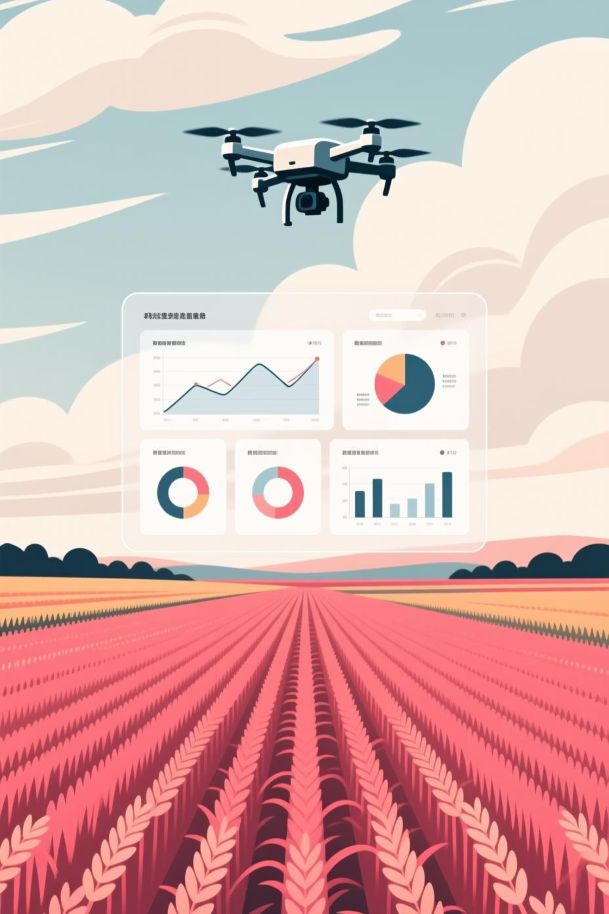
Agri Data Scope: Big Data Analytics for Sustainable Agriculture and Crop Intelligence
A Capstone Project Demonstrating Data-Driven Farming using Databricks and Apache Spark.
Presented By:
K. Srilaya
MBA (General)
24MBMA63

Slide 2
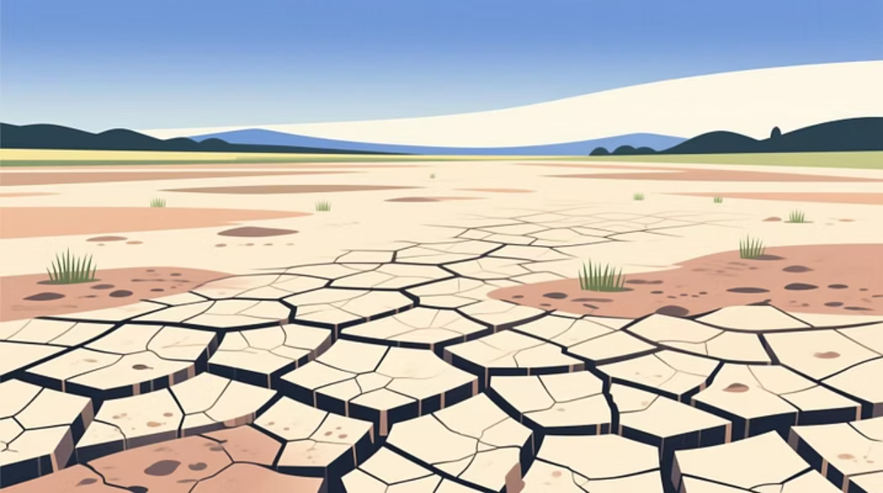

The Challenge and The Solution
Agriculture, the backbone of many economies, faces monumental challenges from climate change, soil degradation, and water scarcity. This project leverages Big Data Analytics to transform traditional farming into a data-driven ecosystem, enhancing productivity and sustainability.
The Challenge
The Solution
Climate volatility and resource depletion demand precise, informed decision-making.
Integrating and analyzing vast datasets (weather, soil, yield) using Big Data tools.

Slide 3
Agri Data Scope: Project Objectives
The project focuses on designing and implementing a modular data pipeline in Databricks using PySpark to derive actionable insights from multi-source agricultural data.
1
2
3
Data Integration & Cleaning
Five Practical Use Cases
Enhance Productivity
Implement models addressing real-world problems: yield prediction, rainfall correlation, soil recommendation, and climate matching.
Demonstrate how Big Data frameworks can lead to better agricultural planning and resource management.
Integrate and clean complex crop, soil, and climate datasets using PySpark for high-quality input.
This study transforms underutilized data from satellites, IoT sensors, and meteorological stations into valuable intelligence for farmers and policymakers.

Slide 4



Framework & Literature Review
Bridging the Gap in Agricultural Data Analytics
Traditional agriculture relies on intuition and manual data handling. Big Data Analytics—combining data mining, machine learning, and predictive models—offers a transformative approach by processing large, diverse datasets (genomics, remote sensing, climate) faster than conventional systems.
Big Data Sources
Faster Processing
Predictive Models
Crop genomics, remote sensing, climate monitoring, market transactions, and farm equipment.
Platforms like Apache Spark and Databricks enable continuous insights for massive, heterogeneous datasets.
Machine learning algorithms forecast yields, optimize resources, and mitigate climate risks.

Slide 5
Core Use Cases: Data-Driven Intelligence
Our project focuses on five analytical use cases critical for modern, sustainable agriculture.
1
Crop Yield Prediction
Predict future yield based on historical FAOSTAT and climate data using regression models (Spark MLlib).
2
Rainfall Impact Analysis
Examine the correlation between rainfall levels, seasonality, and observed crop yield volatility.
3
Crop-Specific Climate Matching
Identify optimal crops for a specific climate region using clustering and correlation methods.
4
Soil Recommendation System
Suggest suitable crops based on specific soil type, pH, and nutrient content (N, P, K) using a Decision Tree classifier.
5
Timing of Key Events (GDD)
Calculate Growing Degree Days (GDD) to identify optimal sowing and harvesting windows for various crops.

Slide 6
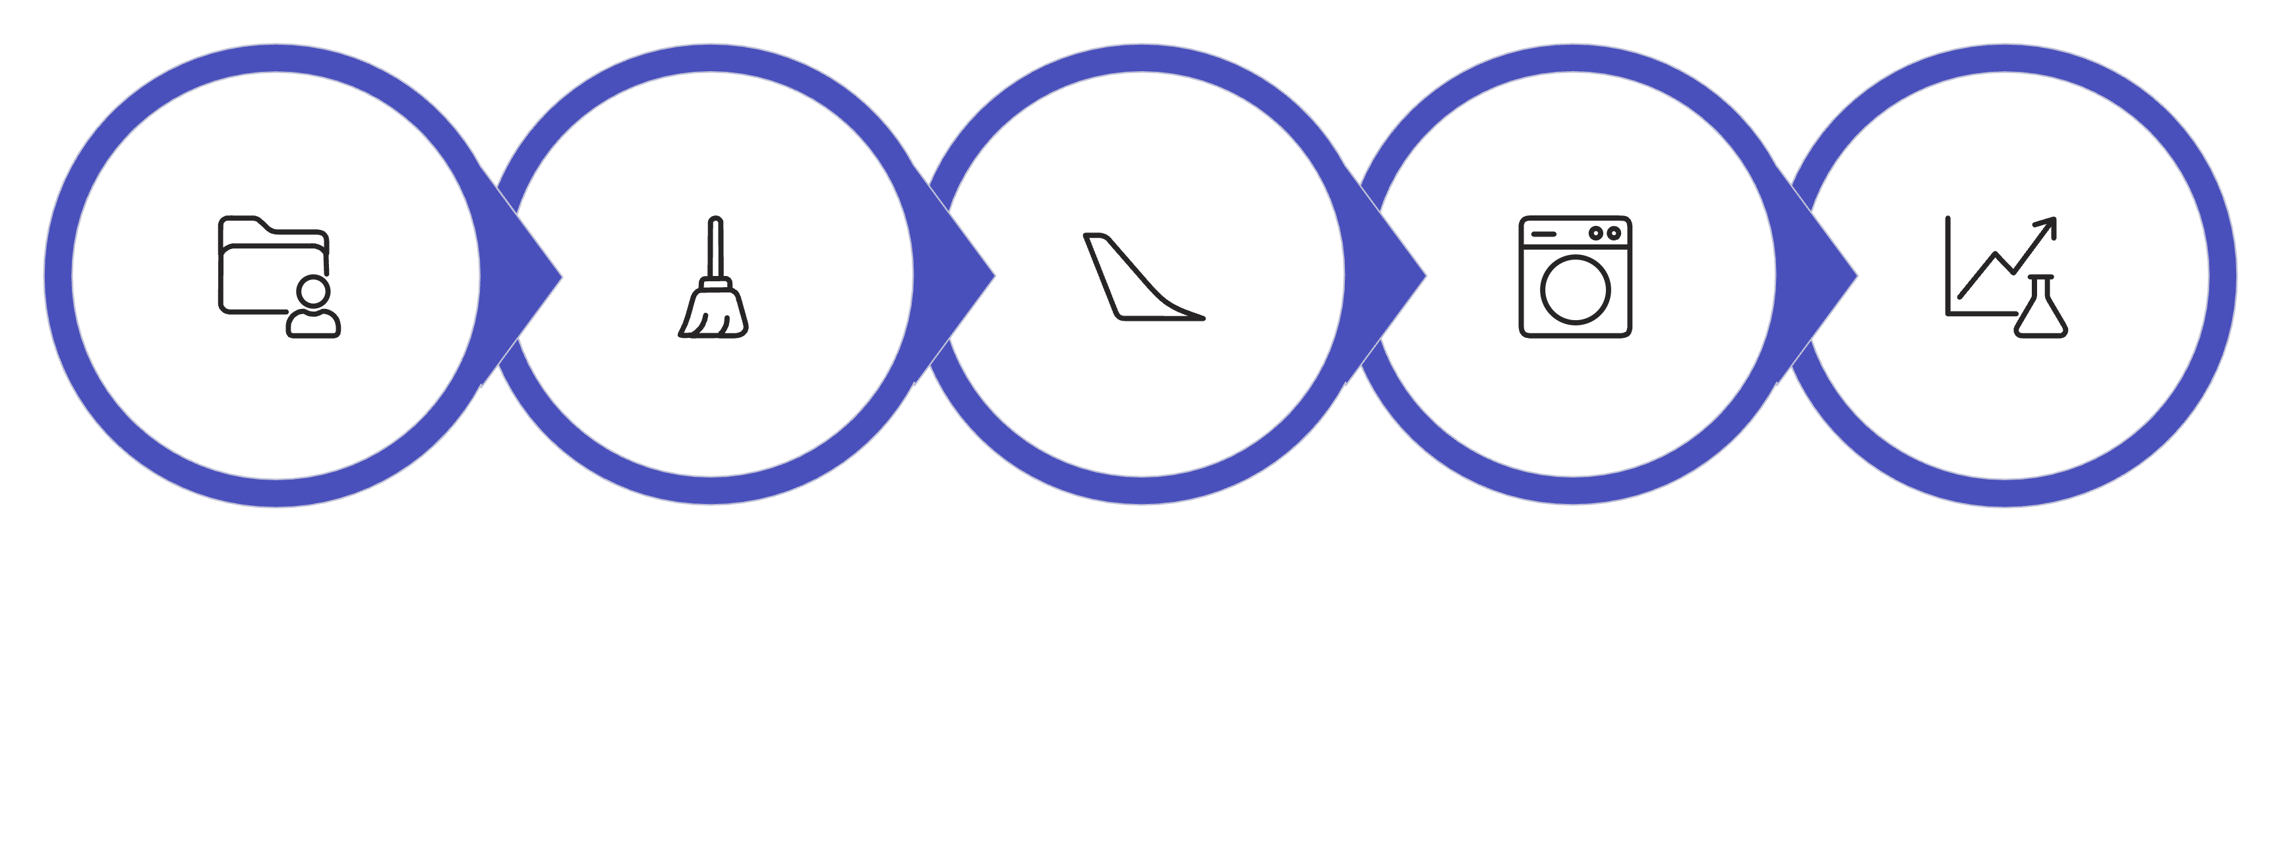
Methodology and Architecture
The Big Data Analytics Lifecycle
We adopted a quantitative, exploratory, and analytical research design, utilizing a structured
Big Data Analytics Lifecycle from raw data ingestion to final visualization.
Data Ingestion
Data Cleaning
Feature Engineering
Modeling & Prediction
Visualization & Insight
Key Tools Used
Data Sources
PySpark: Distributed data processing.
FAOSTAT: Historical crop yield and production data (2000–2025).
Databricks Platform: Cloud-based environment
for the full pipeline.
IMD/Kaggle: Monthly and annual rainfall data.
Delta Lake: Version-controlled, consistent data storage.
ICAR/SHC: Soil pH, NPK, and organic carbon metrics.
Spark MLlib: Machine learning models for predictive analysis.
NOAA: Daily climate records (Temp, Humidity, Rainfall).

Slide 7





Medallion Architecture: The Data Pipeline
The project employs a layered data architecture (Bronze–Silver–Feature–Model–Visualization) in Databricks to ensure data quality, traceability, and scalable processing.
Bronze Layer (Raw Ingestion)
Import raw CSV/Excel files into standardized Delta tables (e.g., bronze_faostat_data). Focus on standardizing column names.
Silver Layer (Cleaning & Transformation)
Handle missing values, remove duplicates, convert data types, and generate initial derived metrics (e.g., average rainfall).
Feature Layer (Engineering)
Combine cleaned datasets and create critical indicators: Soil Fertility Index, Climate Index, and Rainfall Deviation. Ready for ML models.
Model Layer (ML Implementation)
Apply ML algorithms: Linear Regression for yield prediction, Decision Trees for soil recommendation, and K-Means for climate matching.
Visualization Layer (Insights)
Final outputs are visualized in an interactive Databricks Dashboard with charts and graphs showing trends and predictions.

Slide 8

Analytical Results and Insights
Key Findings Across Five Use Cases
A unified Agriculture Insights Dashboard was generated in Databricks, providing policy-makers and
farmers with accurate, data-driven outputs.
0.89
0.83
93%
Yield R² Score
Rainfall Correlation
Soil Model Accuracy
Linear Regression model performance for crop yield prediction.
Strong coefficient indicating high dependency of yield on annual rainfall.
Random Forest Classifier accuracy for soil-to-crop recommendation.
Insight: Optimal rainfall (1100–1400 mm) positively impacts yield up to a saturation point. Furthermore, machine learning
provides 93% accuracy in aligning crop choices with soil health.

Slide 9
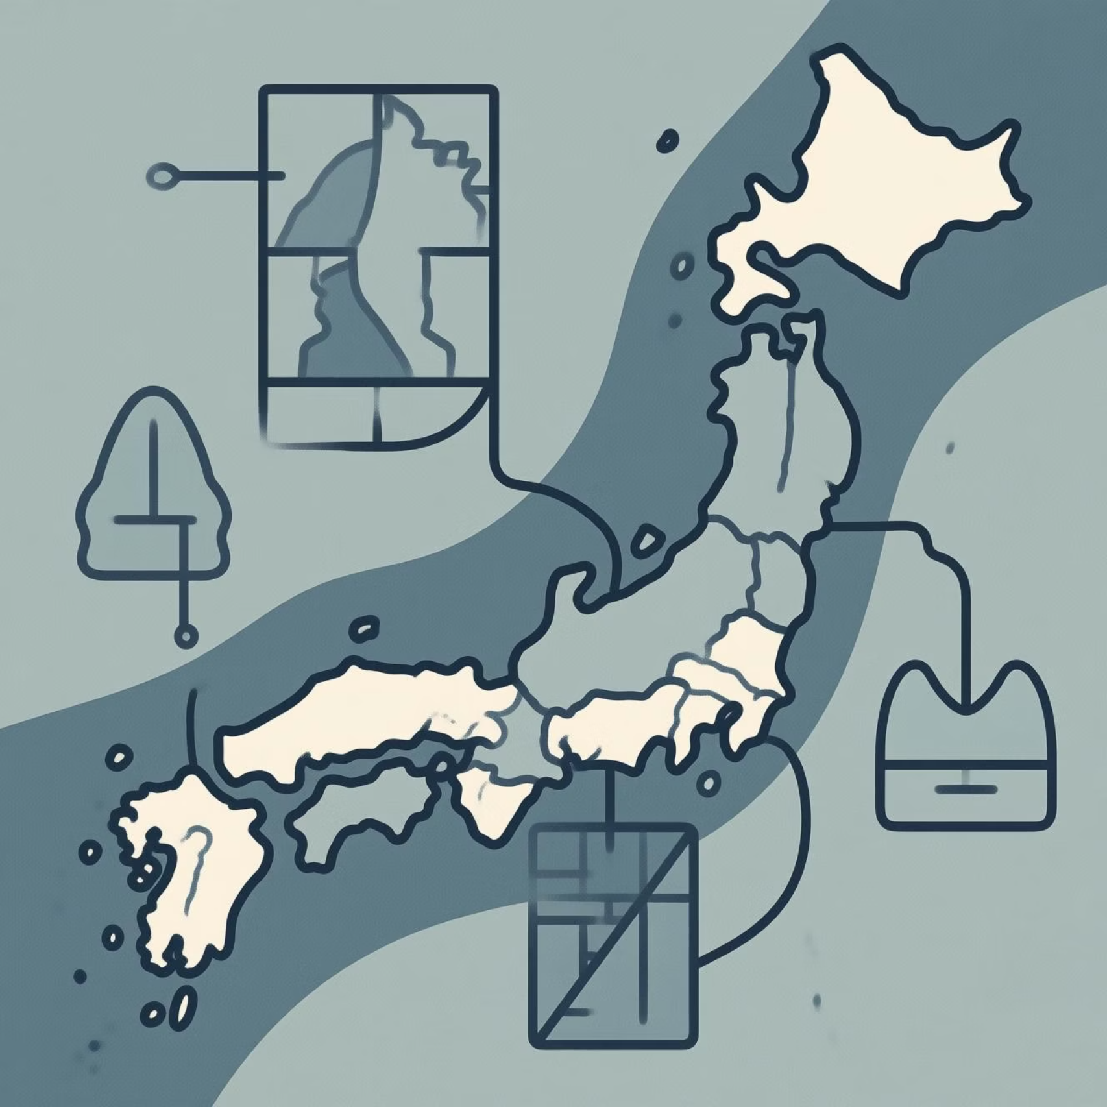
Optimizing Growth: Climate and Soil Matching
By analyzing long-term climate and soil data, we determined optimal growing parameters to maximize crop output and resource efficiency.
Crop-Specific Climate Matching
Rice: Suited for 25–32°C and >1200 mm rainfall.
Wheat: Optimal in 15–25°C range with moderate rainfall (800–1000 mm).
Maize: Thrives in semi-humid areas (20–28°C, 700–1200 mm rainfall).
Soil Type Recommendation
Loamy Soil: Best for Rice and Maize.
Sandy Soil: Recommended for Groundnut and Millet.
Clay Soil: Ideal for Paddy and Sugarcane.

Slide 10


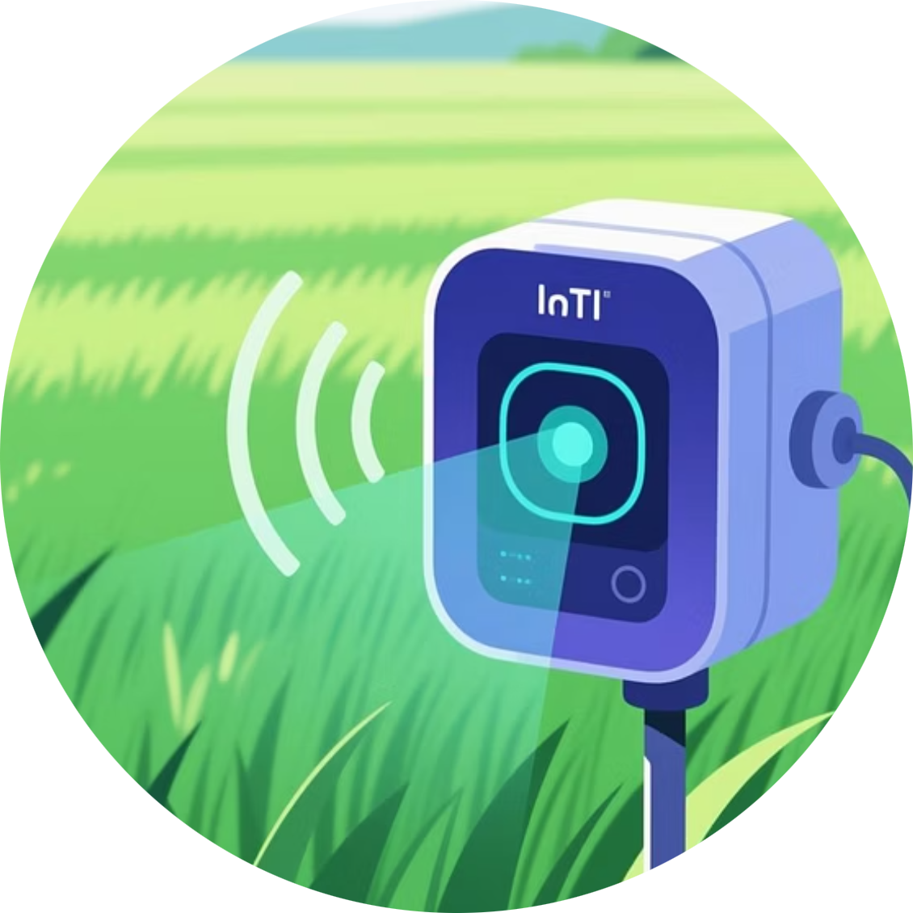
Conclusion and Future Scope
The Agri Data Scope project successfully validates the potential of Big Data Analytics in modern agriculture, providing a strong analytical framework for sustainable farming.
Key Achievement
Future Scope
Advanced Modeling
Successfully created a multi-layered (Bronze–Silver–Gold) pipeline and five analytical models to support decision-making.
Integrate real-time IoT sensor data and geospatial information (satellite imagery) to further enhance model accuracy and provide automated alerts.
Explore Deep Learning (LSTM) and Time-Series Forecasting (ARIMA) for more robust, scalable yield predictions and strategy planning.

